Slide 1
Design, Build or Break Cyber Games for K-12 Education

Slide 2
Technology, Cybersecurity and Policy (formerly the Interdisciplinary Telecom Program)
10,000 unfilled Cybersecurity jobs in CO
3.5 million globally by 2021
MS, BA/MS, BS/MS and Cyber Minor degree offerings
10 new cybersecurity courses
“CYBR” at classes.colorado.edu for Fall 2019
currently “TLEN”
Cybersecurity | Network Engineering | Wireless Engineering
IoT | Blockchain | Cloud Computing | Policy | Law | Economics
Entrepreneurship

Slide 3
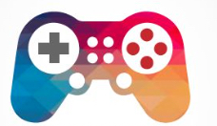
Design-Build-Break Cyber Games for K-12
Challenge Summary
Cyber Game Examples
Prompts
Topic Ares
More Ideas
Project Format
Prizes
Cyber
Games

Slide 4
Design-Build-Break Cyber Games for K-12
Educational Need for Cyber Foundational Skills
Games support learning
Options in Cyber Game Challenge
Design – Game Design Document (GDD)
Build – Mock Up, or Mobile/Desktop Prototype
Break – Create game to teach how to break them

Slide 5
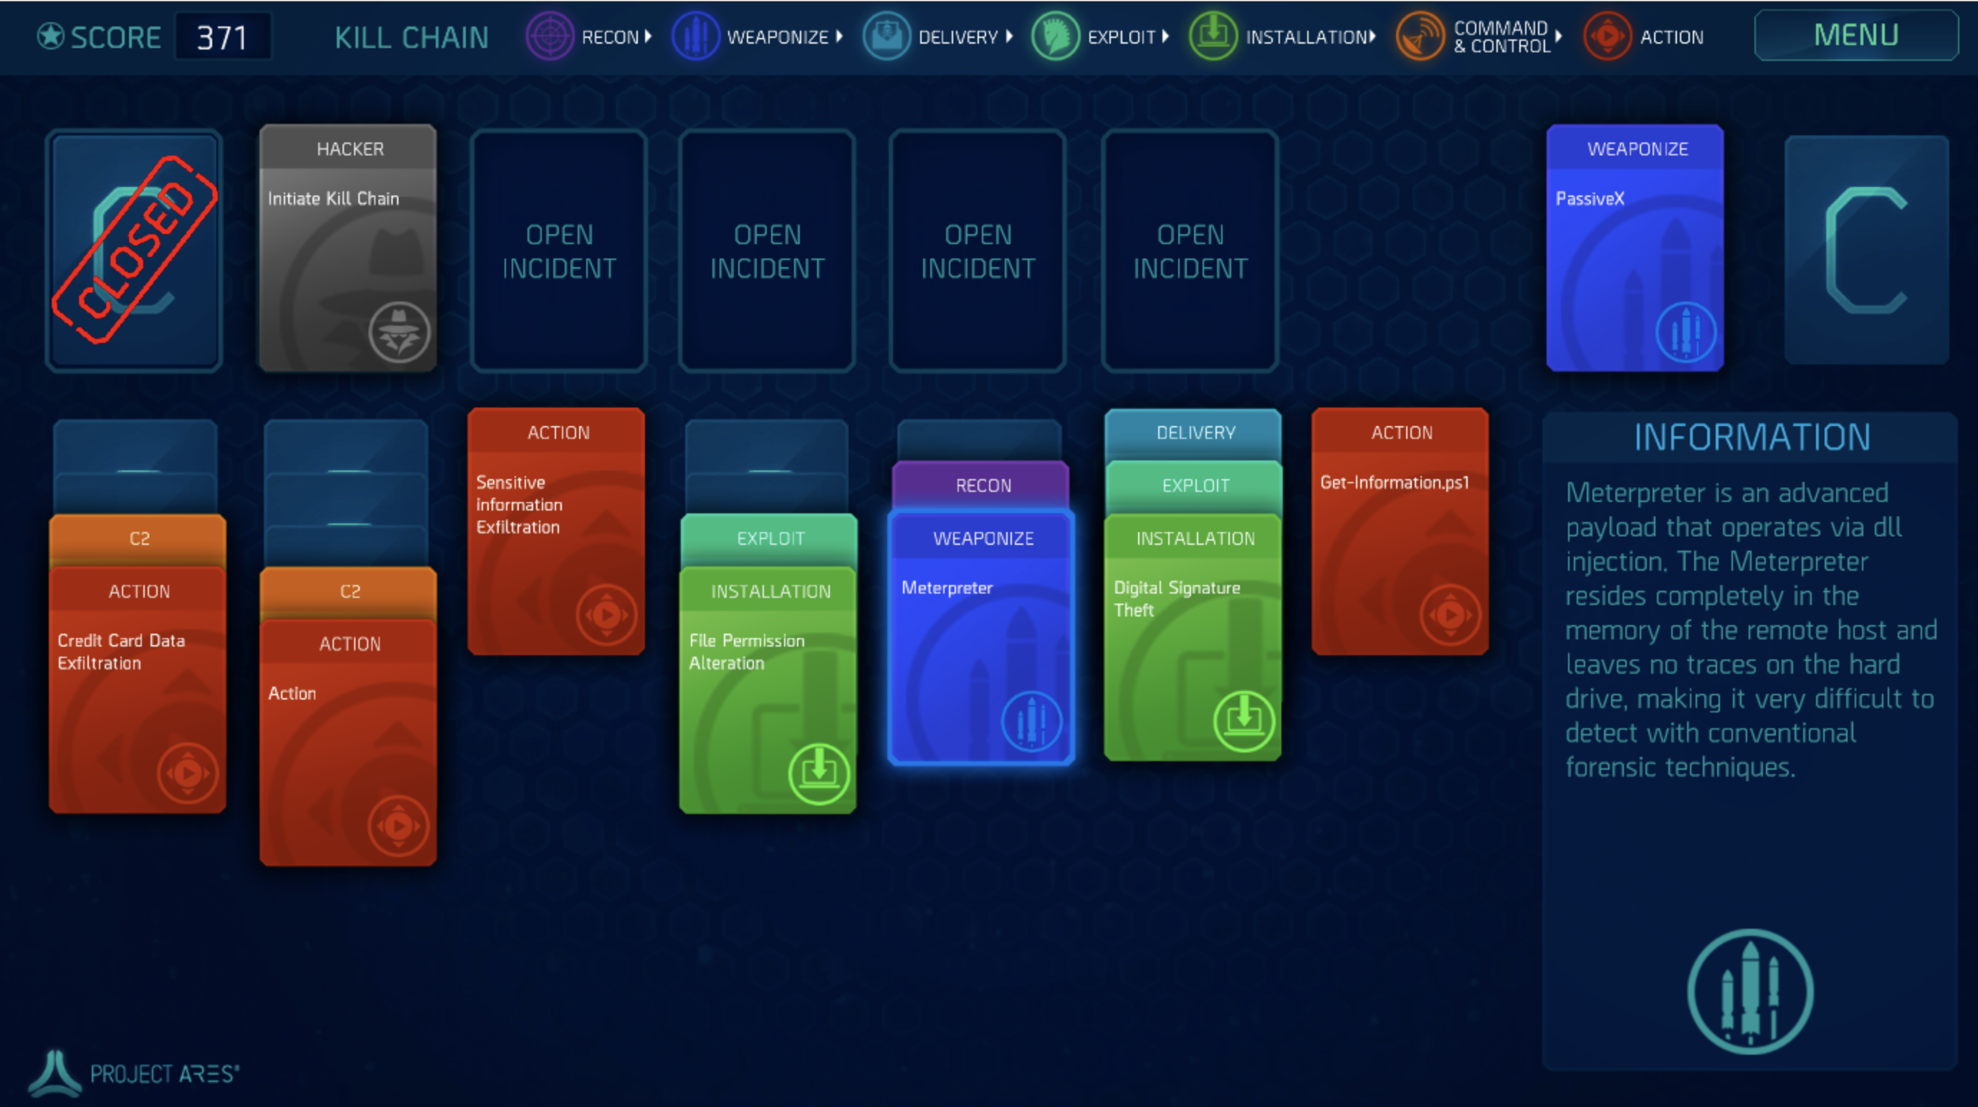
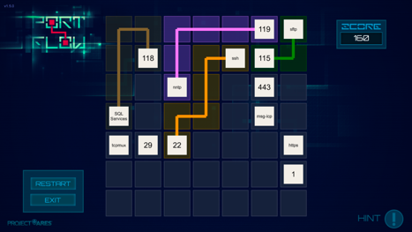

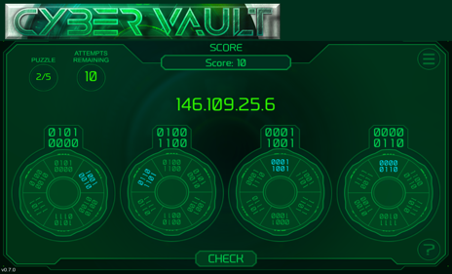
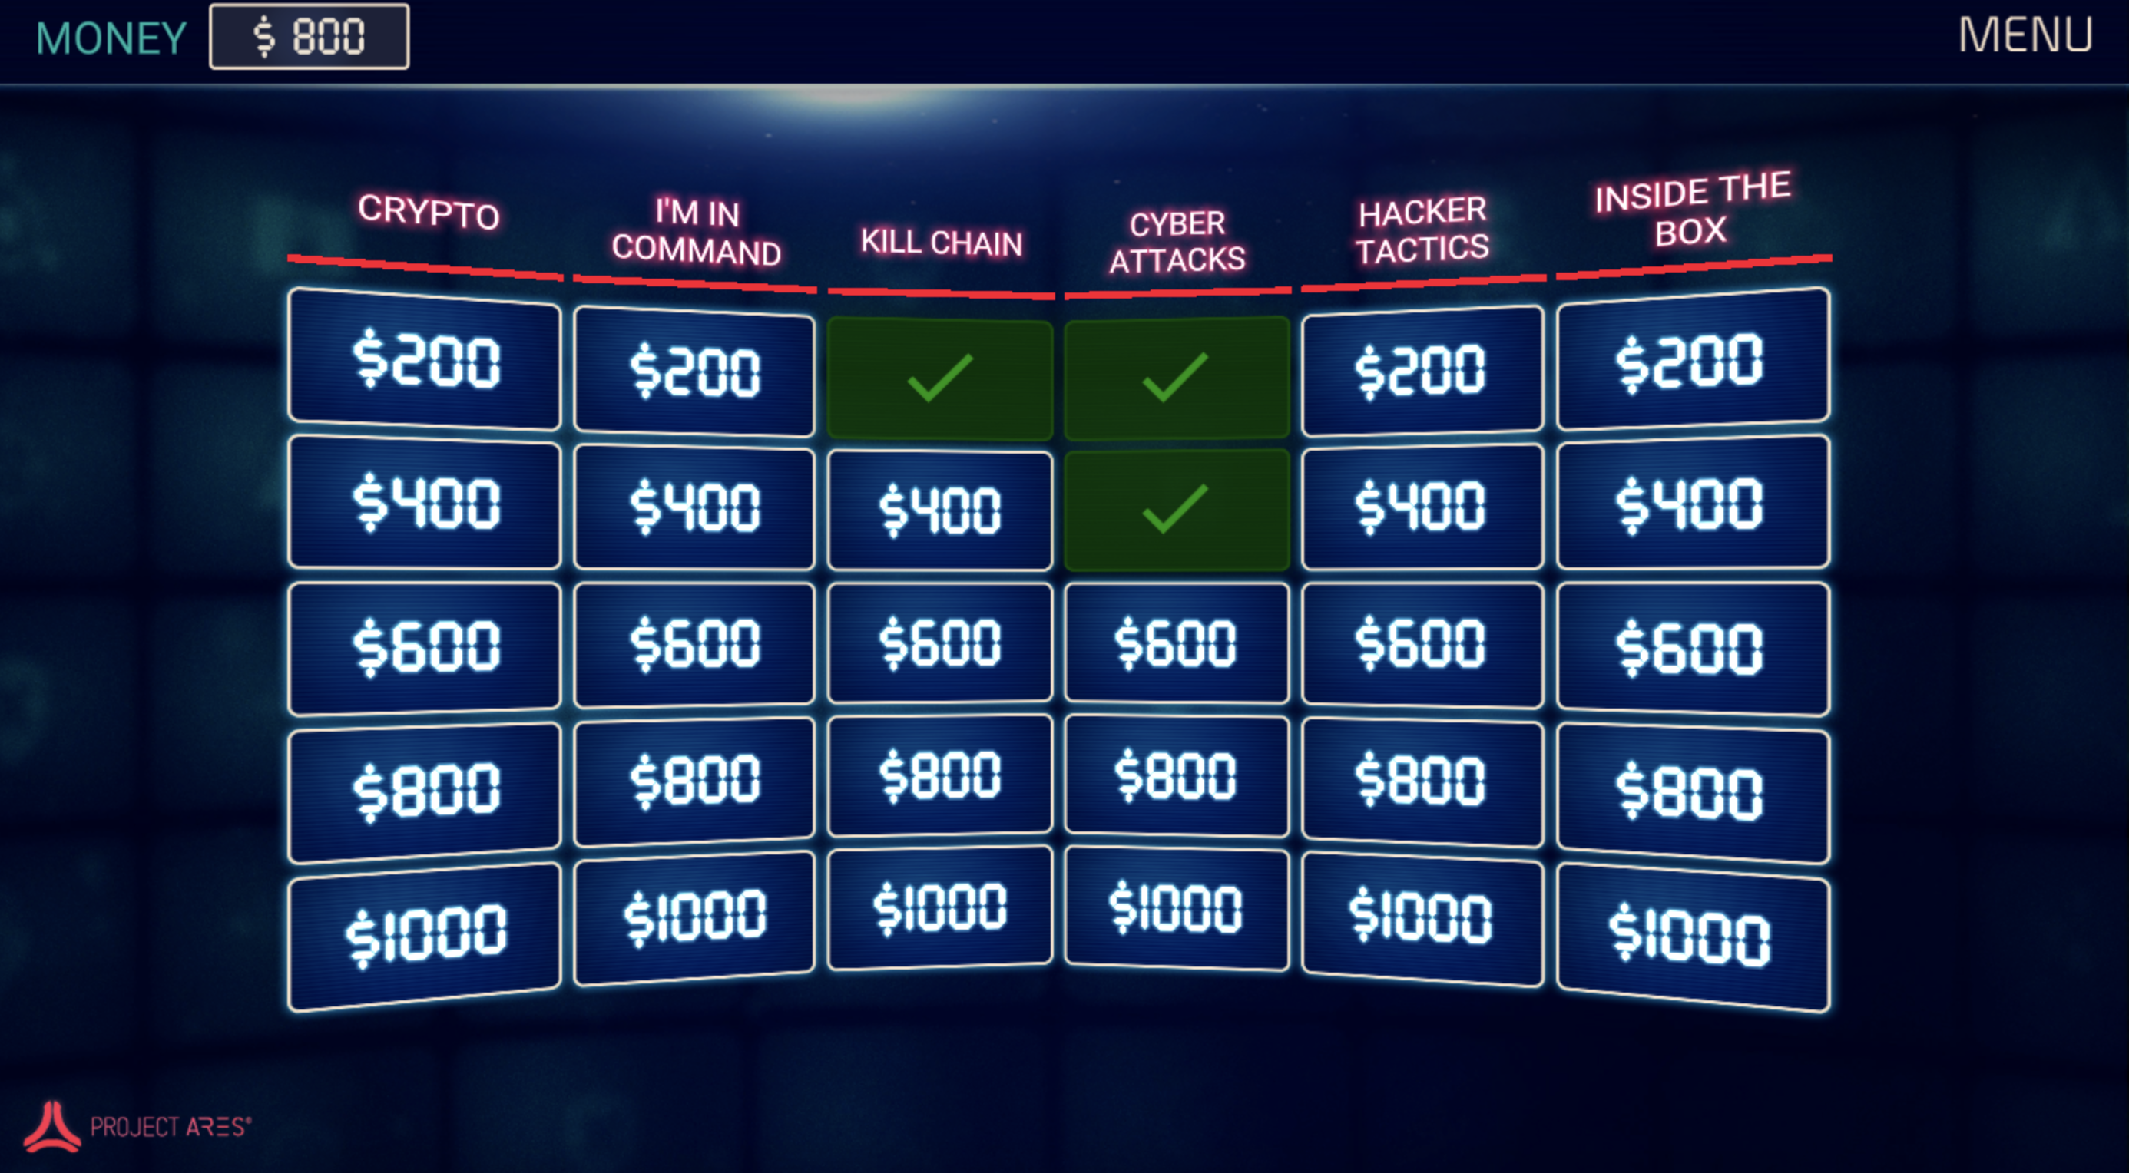

Examples
https://cybergames.circadence.com/

Slide 6
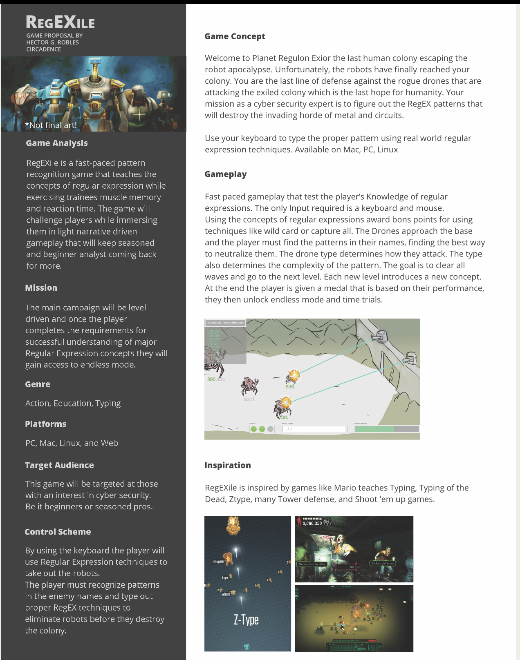
Regular Expressions
Practical Uses in Cyber
Gathering data from large data store
Eliminating extra data from search
IDS Log query
Examples
www.regexone.com

Slide 7
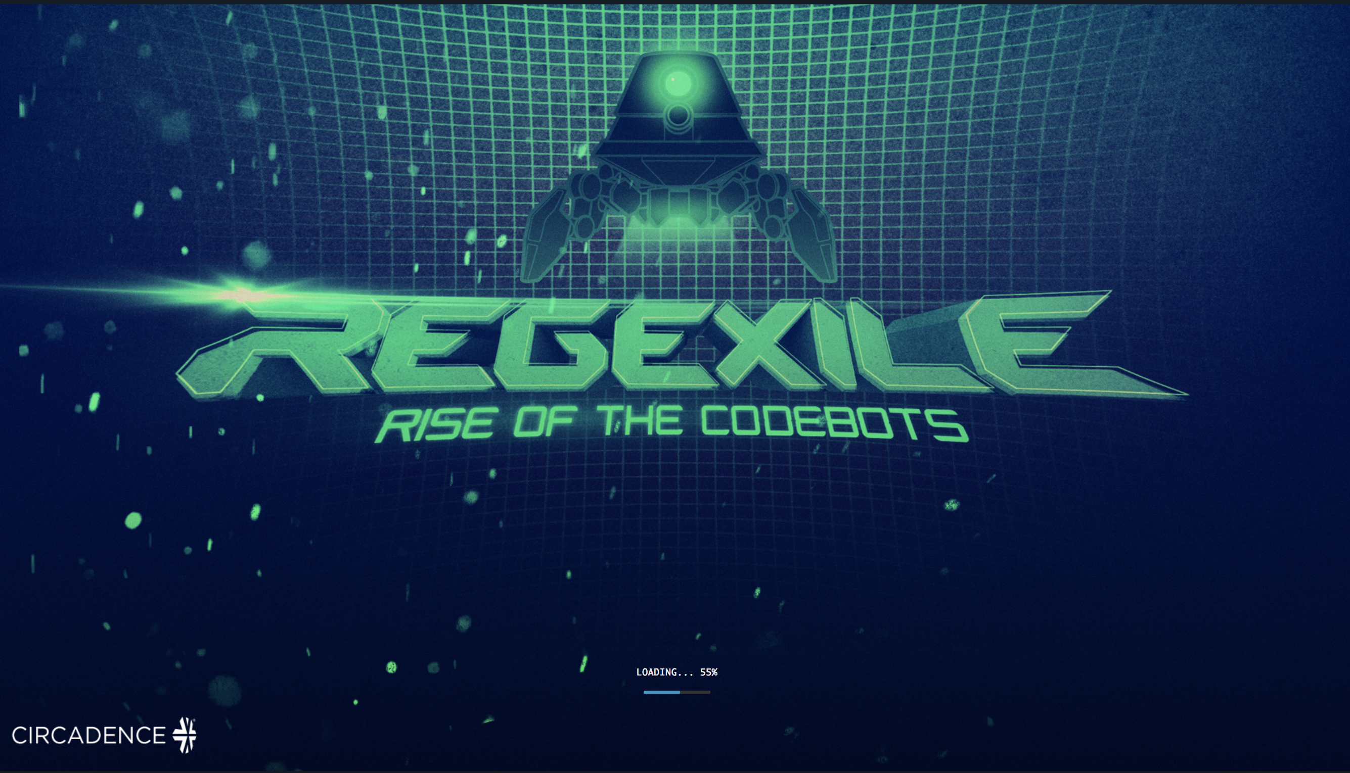
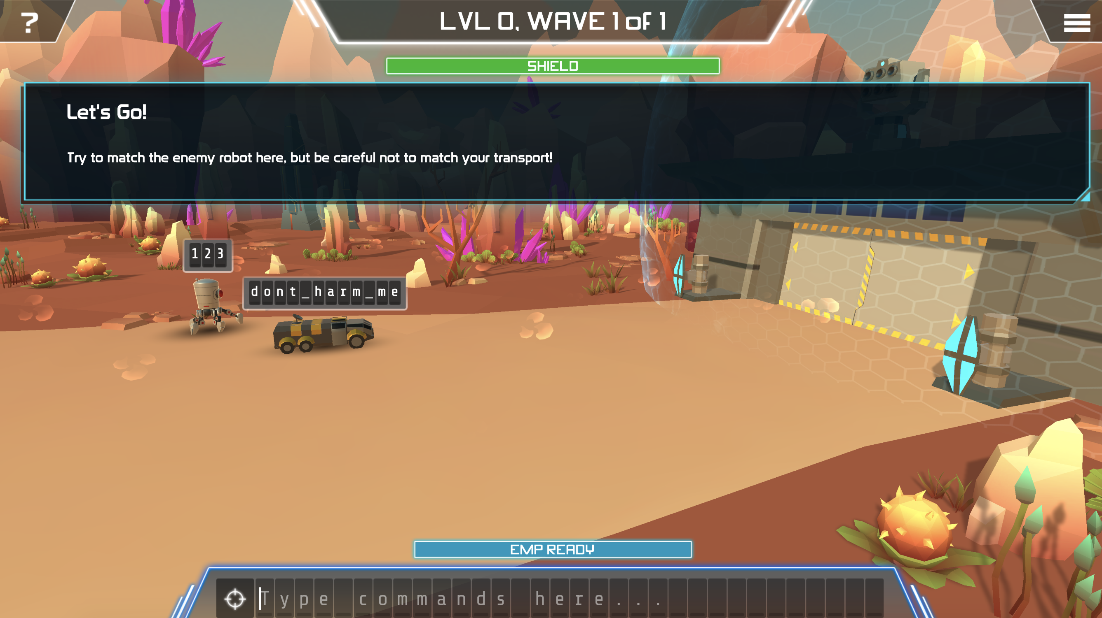
Regular Expressions
https://www.youtube.com/watch?v=AbSdKm5JNSo

Slide 8
Prompts
TCP Cyber Game Challenge

Slide 9
Cyber Game Topics
Cryptography
PowerShell/Scripting
Cyber risk (Probability/Confidence Levels)
Authentication/Authorization
Cyber Key Terrain
Code hacking
Network mapping
Passwords
Firewalls
IDS Rules
Malware Analysis
Incident Response Process
Network Subnetting Design (CIDR)
Network Analysis
General Cyber Hygiene

Slide 10

PowerShell/Scripting
Practical Uses in Cyber
Used by both system administrators and hackers
Gather list of devices on network (or monitor when new one is added)
Comparing files
Reconnaissance of users, files and processes
Monitoring of Active Directory (user accounts) for changes
References and Examples
PowerShellv4 http://technet.microsoft.com/en-us/library/hh857339.aspx
Cyber Aces Scripting (Free, on-line) for basic scripting and programming

Slide 11

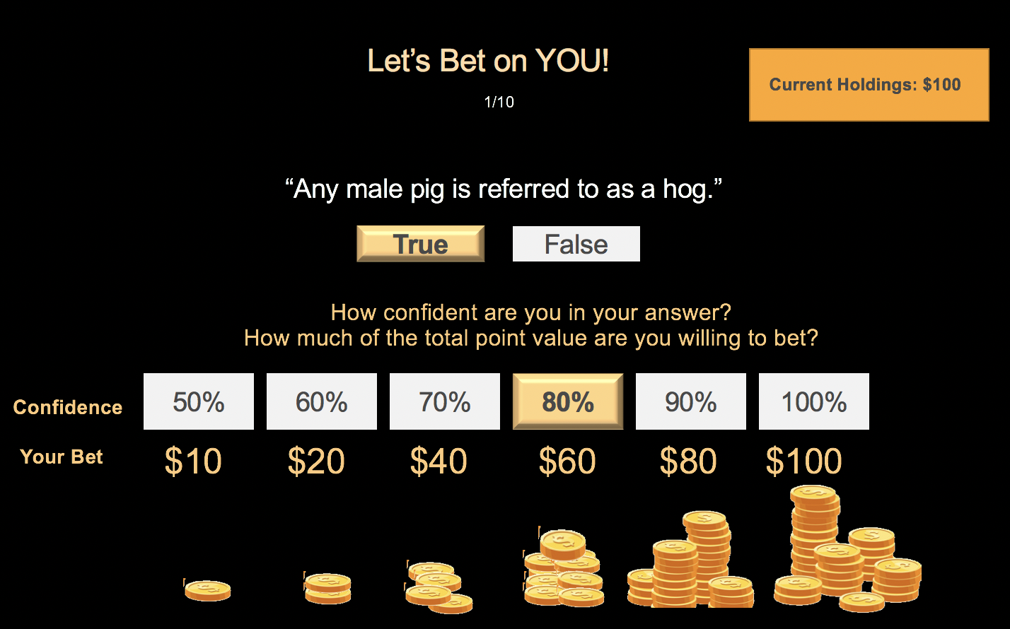
Cyber Risk
Learning Goals/Messages
Cyber Risk = Probability X Impact
Players need to be comfortable in estimating probability and confidence level
Let’s Bet on You!
Wheel of Chance
Oh Crap(s)
Is it SAFE?

Slide 12
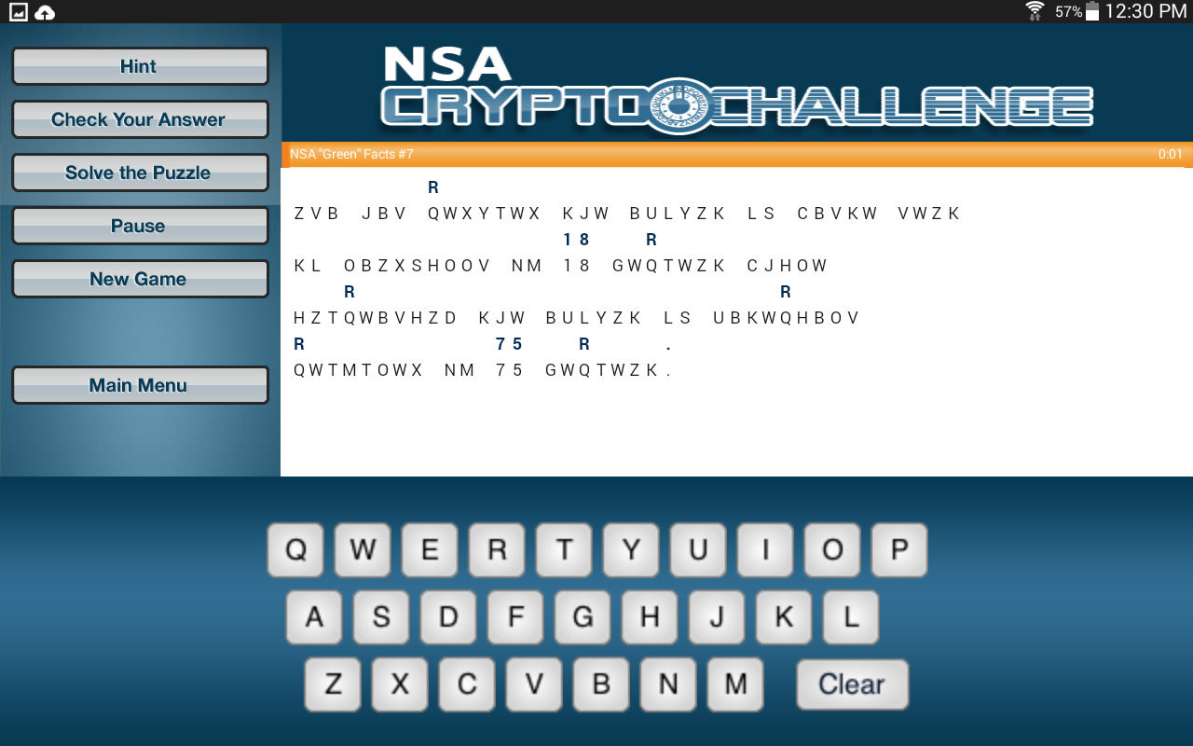
Cryptography
Learning Goals/ Messages
Understand what encryption/cryptography is. It’s just math to hide create a secret code. Historically, there have been examples for 1000’s of years. Explain Scytale (rhymes with Italy).
how frequency analysis (e.g., which requires more data) to solve puzzles
Technology progress in computing have made it easier/faster to break codes (always evolving, never perfect).
It takes time (availability concerns) to encrypt/decrypt everything! Use it wisely.
It takes management overhead with key management nightmares. Use it wisely.
References
http://www.maths.manchester.ac.uk/cryptography_competition_the_imitation_game/index.php
https://www.cryptoclub.org/#vDesertOasis
Cryptography Curriculum
Encryption/decryption, sender authentication, data integrity, non-repudiation
Attack classification (ciphertext-only, known plaintext, chosen plaintext, chosen ciphertext)
Secret key (symmetric), cryptography and public-key (asymmetric) cryptography
Information-theoretic security (one-time pad, Shannon Theorem)
Historical Ciphers
Shift cipher, affine cipher, substitution cipher, Vigenere cipher
Hill cipher, Enigma machine

Slide 13
Authentication and Authorization
Learning Goals/ Messages
Know the difference between Identity, AuthN, AuthZ
Authentication Types
PINs, Passwords, Token/Key
Plusses and minuses of each
Authorization schemes
Role
Comes with a cost of complexity!

Slide 14
Challenge Format
TCP Cyber Game Challenge

Slide 15

Challenge Format – Design
Game Title
Summary
The Elevator Pitch
Theme/Genre
Audience
Game Flow Summary
Educational Design
Learning Objectives
Puzzle/Challenge Structure
Play Flow
Storyline
Setting
Characters
Visuals
Game Play Mechanics
Controls
Levels
Technical Requirements: AI, Art Assets
Scoring Method
Game Design Document (GDD)

Slide 16
Challenge Format - Build
Mock up (chart flip through)
Physical game play (e.g., cards)
Unity3D or UnReal Game Prototype
Mobile App
Just about anything that gets across the game play and learning method!

Slide 17
Challenge Format - Break
Example game that can be hacked
Appropriate to age group
Teaches cybersecurity principles through ”hacking”
Process that demonstrates hacking
For example, improper inputs cause unintended results
OWASP Top 10 for Web Apps
Essentially Reverse Engineering/Pentesting for Kids

Slide 18
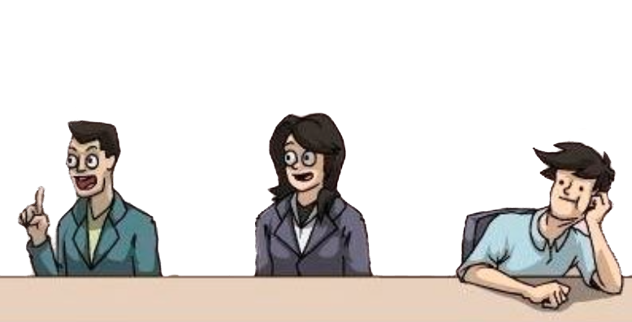
Judging Criteria
Judges will include experts in cybersecurity, game prototyping, and K-12 education from TCP, Circadence, and the St. Vrain Valley School District.
Educational Merit
Does it teach a topic relevant to Cyber
Fun and Engaging
Does it fit the target audience
Realistic/Complete
Is the design or prototype sufficient to plan the MVP

Slide 19
Prizes
TCP Cyber Game Challenge

Slide 20
Prizes for TCP Cyber Game Challenge
Winning projects will be selected for potential future development and use for
K-12 education with the TCP Program and Circadence in local school districts.
First Place – choice of:
Free trip to the Pentagon (DoD Headquarters) with the TCP Program
Paid airfare, lodging, and custom tour for 3 days, 2 nights
Nintendo Switch Game Consoles
Second Place – choice of:
Circadence Project Ares Licenses
Google Home Minis - Smart Speakers with Google Assistant
Third Place:
Tile Mate Item Trackers (2/person)
All: Pride and TCP SWAG

Slide 21
Mentors
Daniel Massey, PhD – Director, TCP Program; Neutral Vehicle research project; K-12 Cybersecurity Education in St. Vrain Valley School District
Laura Lee, JD, MA – Executive Vice President of Rapid Prototyping, Circadence
Daniel Manson, PhD – Instructor, TCP Program; Western Region Collegiate Cyber Defense Competition; CyberPatriot Competition
Lijun Chen, PhD – Asst. Professor, TCP Program & Dept. of Comp. Sci.
Sangtae Ha, PhD – Asst. Professor, TCP Program & Dept. of Comp. Sci.
Will Temple – PhD Candidate, CU’s Dept. of Comp. Sci.; Dr. Ben Shaprio’s Laboratory for Playful Computation
CU’s Cybersecurity Club and Collegiate Cyber Defense Competition Team’s students are willing to assist with projects as needed.

Slide 22
CU Cybersecurity
Club
Department of Computer Science

